Slide 1

Introduction to Gesture-Controlled Volume
Gesture-controlled volume is an innovative technology that allows users to adjust audio levels using natural hand movements. This hands-free approach enhances convenience and accessibility, making it a game-changer in various applications.
:

Slide 2
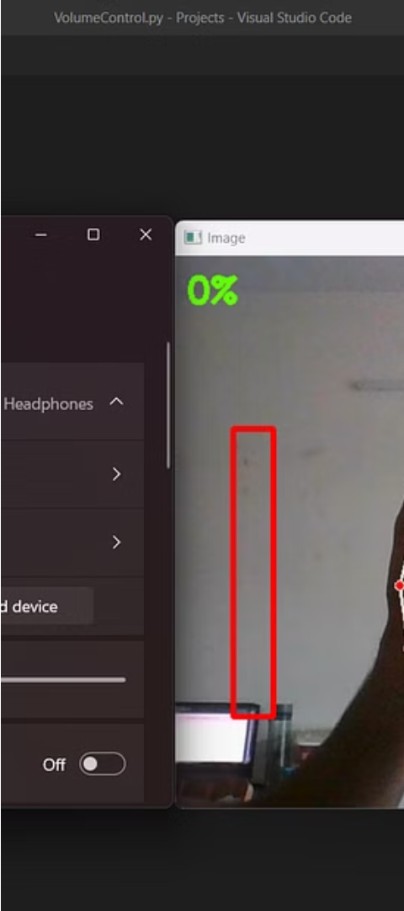
Importance of Hands-Free Volume Adjustment
1
Increased Accessibility
2
Enhanced Convenience
Enables users with limited mobility or dexterity to control volume intuitively.
Allows for quick and seamless volume adjustment without the need to reach for physical controls.
3
Improved Hygiene
Reduces the need to touch shared devices, promoting a more hygienic environment.

Slide 3
Overview of Python-Based Gesture Recognition
Computer Vision
Machine Learning
Real-Time Processing
Leverages OpenCV, a powerful computer vision library, to detect and track hand movements.
Utilizes machine learning algorithms to classify hand gestures and map them to volume control commands.
Processes video frames in real-time, enabling immediate volume adjustments based on user gestures.

Slide 4
Hardware Requirements and Setup
Camera
Computing Power
A standard webcam or USB camera is required to capture hand movements.
A moderately powerful computer or single-board computer, such as a Raspberry Pi, can handle the processing.
Audio Interface
Lighting Conditions
Integration with the system's audio output is necessary to control the volume levels.
Optimal lighting is important for accurate hand detection and tracking.

Slide 5
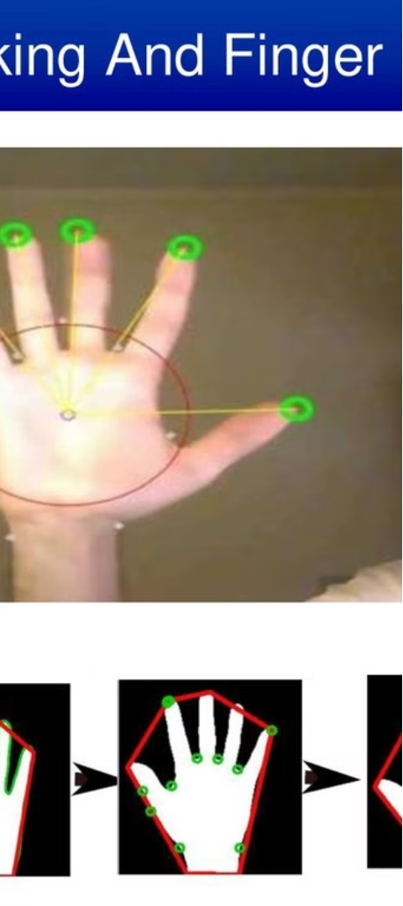
Implementing Hand Tracking with OpenCV
1
Hand Detection
Use OpenCV's built-in hand detection algorithms to identify the presence of hands in the video feed.
2
Hand Landmark Extraction
Locate and extract key landmarks, such as fingertips and joints, to track the hand's position and movement.
3
Continuous Tracking
Implement techniques like optical flow or Kalman filtering to maintain smooth and accurate hand tracking over time.

Slide 6



Mapping Hand Gestures to Volume Control
Increase Volume
Decrease Volume
Confirm Volume
Raising an open palm can be interpreted as a command to increase the volume.
Forming a fist can be used to decrease the volume.
A thumbs-up gesture can be used to confirm the desired volume level.

Slide 7
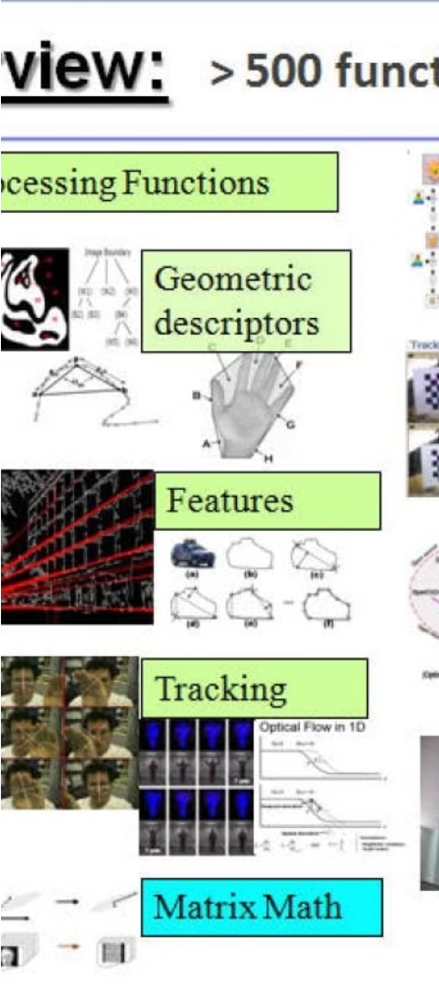



Optimizing Gesture Recognition Accuracy
Data Collection
Gather a diverse dataset of hand gestures to train the machine learning model.
Model Training
Experiment with different machine learning algorithms and hyperparameters to improve recognition accuracy.
Real-Time Adaptation
Implement techniques like transfer learning to adapt the model to each user's unique hand characteristics.

Slide 8
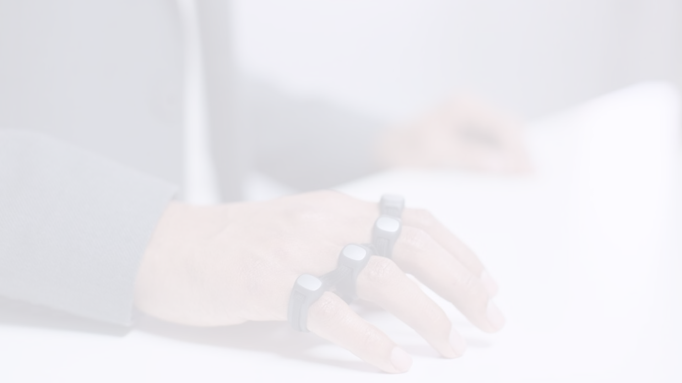
Conclusion and Future Enhancements
1
Endless Possibilities
2
Ongoing Advancements
3
Expanded Applications
Gesture-controlled volume has the potential to revolutionize how we interact with technology, improving accessibility and convenience.
Continued research and development in computer vision and machine learning will further enhance the accuracy and robustness of gesture recognition.
The technology can be extended beyond volume control, enabling hands-free interaction with various devices and systems.

Slide 9


